Slide 1
Mobile Commerce
Unit 5

Slide 2
Introduction to Mobile Commerce
Services of M-Commerce
Difference between M-commerce and PC based E-commerce
Advantages and Disadvantages of M-commerce

Slide 3


Slide 4
Introduction
Mobile Commerce , also known as m-commerce, is defined as the process of performing business transactions using handheld mobile devices which are connected through wireless networks. The business transaction may range from buying and selling of goods, making mobile payments, downloading audio/ video contents, playing online games, using numerous software applications or getting booking tickets.

Slide 5
Mobile devices include cellular phone, handheld computers such as palmtops or laptops, pagers, smartphones and Personal Digital Assistants (PDA).
The mobile users can access internet through these devices without any wired connection.
Using WAP (Wireless Application Protocol), m-commerce employs web-ready micro browsers in these mobile devices to surf through the internet anytime, anywhere.
WAP enabled smartphone equipped with Bluetooth technology offer fax, email and phone capabilities to the user to facilitate business transactions while in TRANSIT

Slide 6
The content delivery over wireless mobile devices has become more faster, safer as well as cheaper
M-commerce allows choice for performing digital business transactions.
Sometimes referred to as next generation e-commerce.

Slide 7
Mobile Commerce can be broadly divided into three categories

Slide 8
Mobile Banking | It is a state of art process that has been introduced in the banks to make sure that the customers are better equipped with all the systems and process. Mobile banking is accessed through mobile and people can use it for benefit as customers physical presence is not required. This has made life a lot easier
M-Payment (Mobile payment) | It is a point of sale payment made through a mobile device, such as cell phone, personal digital assistant (PDA) Using m-payment, a person with a wireless device could pay for items in a store or settle a restaurant bill without interacting with any staff member
Mobile Money | Mobile Wallets

Slide 9
Unique features of M-Commerce
Mobility and availability
Savings on electricity
Comfort, convenient and spontaneity
Speed
Easy user experience
Smart CRM

Slide 10
Use of Mobile Commerce

Slide 11
Mobile Banking
Mobile Browsing and purchase
Mobile content purchase and delivery
Mobile money transfer
Information and location based services
Mobile advertising
Mobile ticketing, vouchers and coupons

Slide 12
Why do users prefer using mobile devices in transactions and commercial activities
Mobile devices improve efficiency
Mobile devices promote timeliness
Mobile device improve communications and relationships between parties involved
Mobile devices offer a wider reach

Slide 13
Wireless Communication Technology
M-commerce is based on wireless communication technology, the data transfer is facilitated by microwaves, radio waves or infrared waves. It eliminates the cumbersome cabling process.

Slide 14
Scope of Mobile Commerce
Mobile Commerce provides instant connectivity between mobile users irrespective of their geographical location and time of the day.
Spread across the globe

Slide 15
Application of M-Commerce
Downloading MP3 music, playing online games or participating in line video conferencing while in transit have become a reality now.
SMS based text messaging finds wide acceptance in day to day business transactions.
Another major application area of m-commerce is in the field of micro payments.
Mobile phones have replaced credit cards, money in the pockets.
Mobile phones equipped with a contact less smart card , can act as a digital card, uses NFC (Near Field Communication) technology

Slide 16
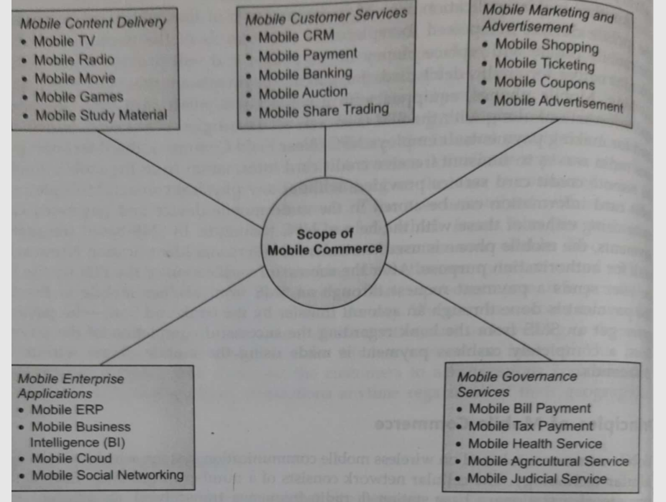

Slide 17
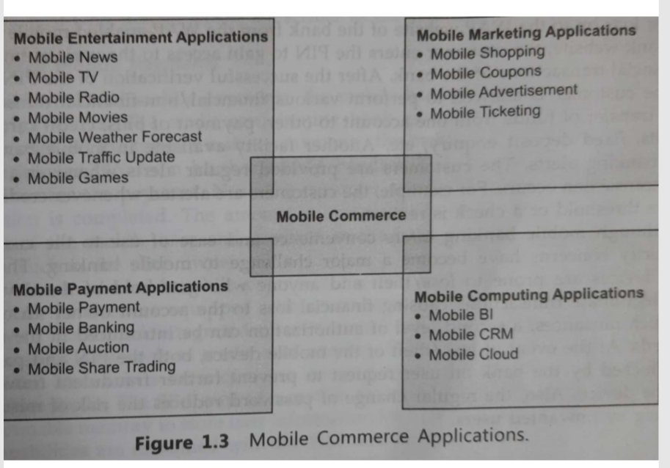

Slide 18
Requirements of m-commerce system
It should enable end users to conduct mobile commerce transactions easily, in a timely manner, and ubiquitously.
It should allow products and services to be personalized or customized upon user request and demand. (Customization)
It should fully support a wide range of mobile commerce applications for content providers; therefore they can design their content with different software's

Slide 19
Maximum compatibility is desirable and needed because so many technologies are now available and new techniques are constantly being added to mobile commerce systems.
Program/data independence is held, it can result into change of system components does not affect the existing programs/data.

Slide 20
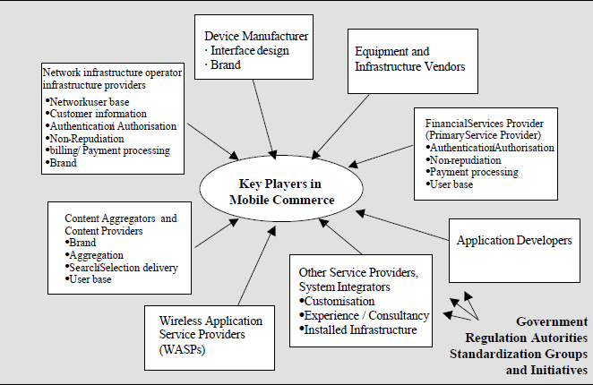

Slide 21
Mobile Service Scenarios
Financial Services.
Entertainment.
Shopping.
Information Services.
Payment.
Advertising.
And more ...

Slide 22
Early content and applications have all been geared around information delivery but as time moves on the accent will be on revenue generation.
Entertainment
Music
Games
Graphics
Video
Pornography
Communications
Short Messaging
Multimedia Messaging
Unified Messaging
e-mail
Chatrooms
Video - conferencing
M- commerce
Transactions
Banking
Broking
Shopping
Auctions
Betting
Booking & reservations
Mobile wallet
Mobile purse
Information
News
City guides
Directory Services
Maps
Traffic and weather
Corporate information
Market data

Slide 23
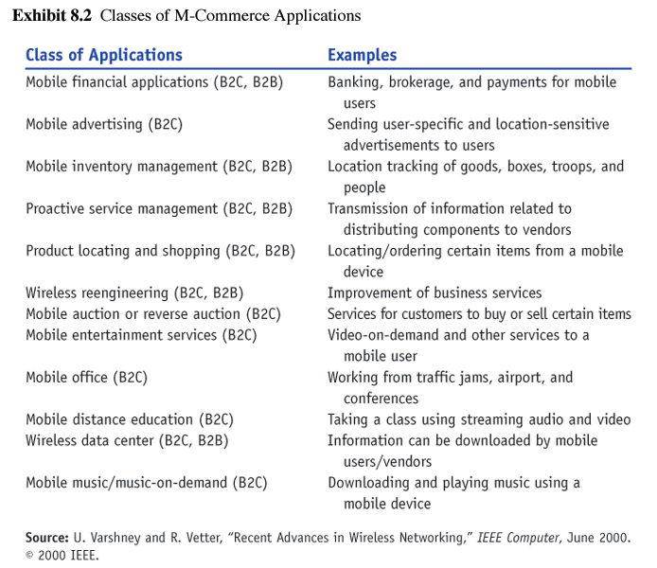
Classes of M-Commerce Applications

Slide 24
Limitations of M-Commerce
Usability Problem
small size of mobile devices (screens, keyboards, etc)
limited storage capacity of devices
hard to browse sites
Technical Limitations
lack of a standardized security protocol
insufficient bandwidth
4G licenses'

Slide 25
Limitations of M-Commerce
Technical Limitations…
transmission and power consumption limitations
poor reception in tunnels and certain buildings
multipath interference, weather, and terrain problems and distance-limited connections
WAP Limitations
Speed
Cost
Accessibility

Slide 26
Limiting technological factors
Networks
Bandwidth
Interoperability
Cell Range
Roaming
Mobile Middleware
Standards
Distribution
Localisation
Upgrade of Network
Upgrade of Mobile
Devices
Precision
Security
Mobile Device
Network
Gateway
Mobile Devices
Battery
Memory
CPU
Display Size

Slide 27
Potential Health Hazards
Cellular radio frequencies = cancer?
No conclusive evidence yet
could allow for myriad of lawsuits
mobile devices may interfere with sensitive medical devices such as pacemakers

Slide 28
Benefits of Ecommerce
Anytime
Anywhere
Cost effective
Personalized Services

Slide 29
Limitations of E-commerce
Small screen size
Low speed processor
Small memory capacity
Wireless network limitations
Bandwidth restrictions
Security issues

Slide 30
Limitations of E-commerce
Mobile device limitations
Small screen
Low speed processor
Small memory capacity
Wireless network limitations
Bandwidth restrictions
Security issues

Slide 31
Trends of M-commerce
Chatbots
Augmented reality
Geofencing
Purchase via one click
Personalization
Big data
Increased trust
Faster checkouts
Easier of use sites

Slide 32
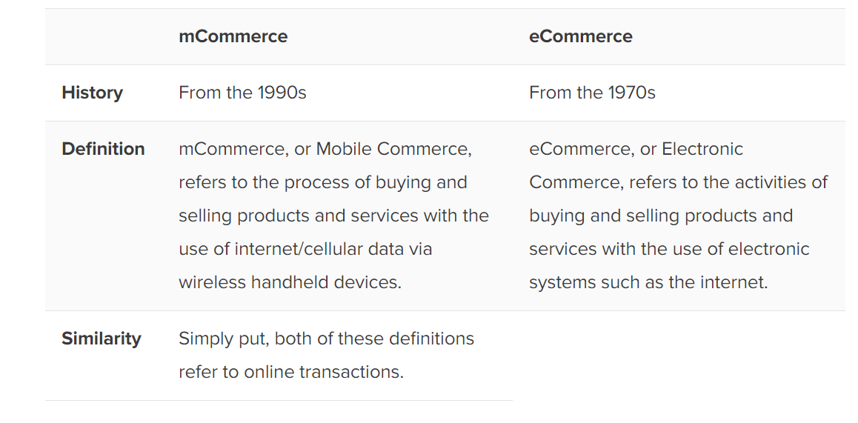

Slide 33
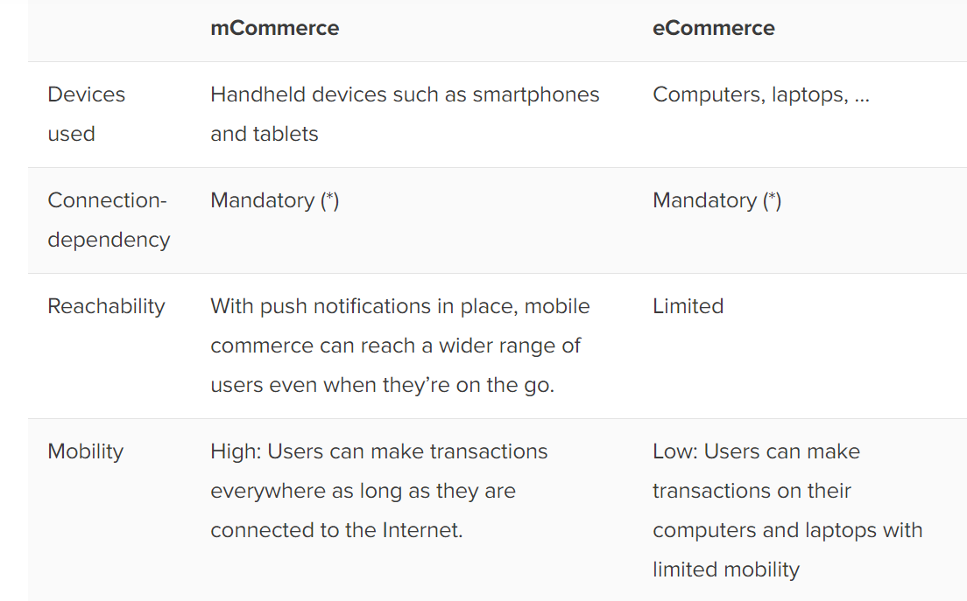

Slide 34
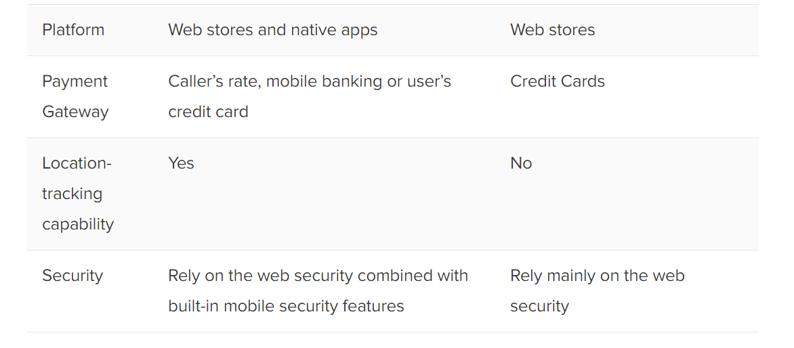

Slide 35
Widespread use of Mobile Apps
Apps are dedicated
Apps can easily utilize the features
Some apps can be use offline (memory management and storage)
Apps load quickly
Apps are available for almost anything

Slide 36
Advantages of Mobile apps
Provides relevant information
Provides discount, offers and rewards
Use of mobile app as a marketing channel

